Slide 1
跟着Kevin学英语(11)
Hiccups

Slide 2
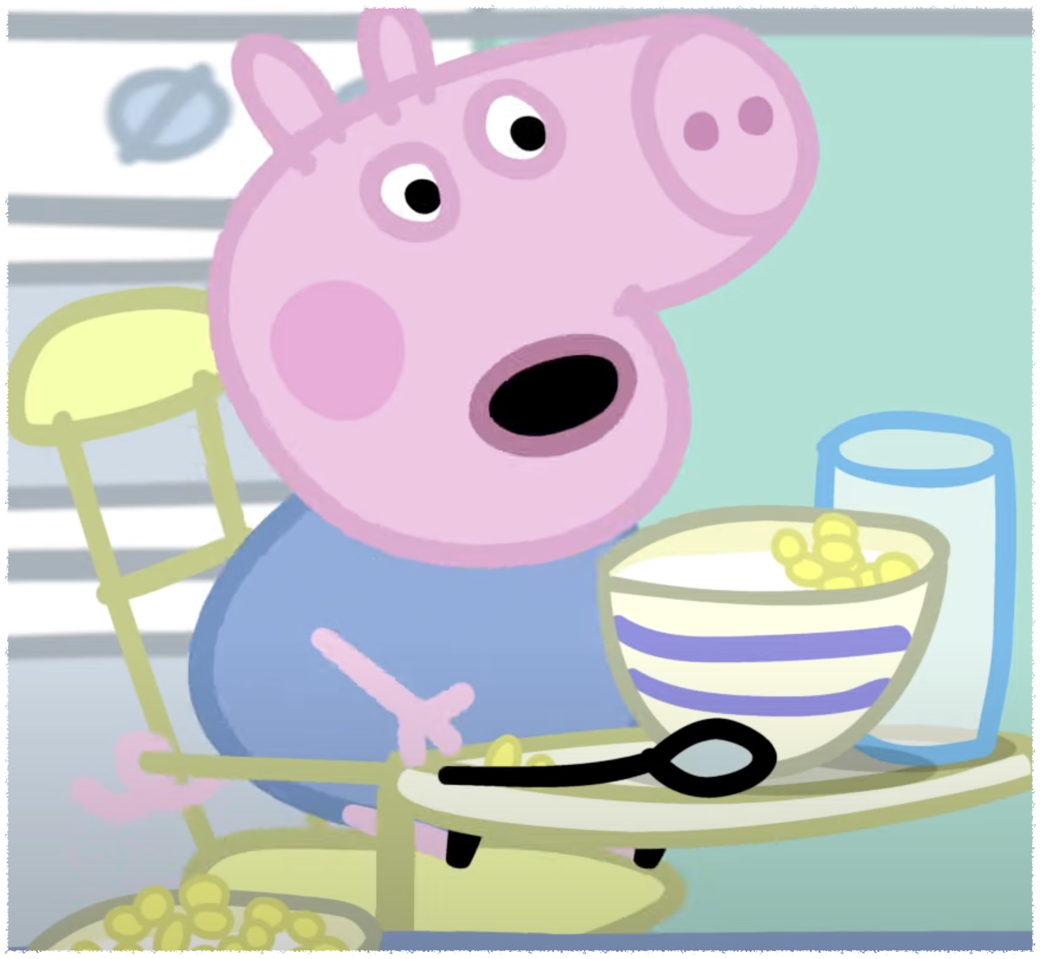
H h
Hiccup
Notes:
George has hiccups

Slide 3
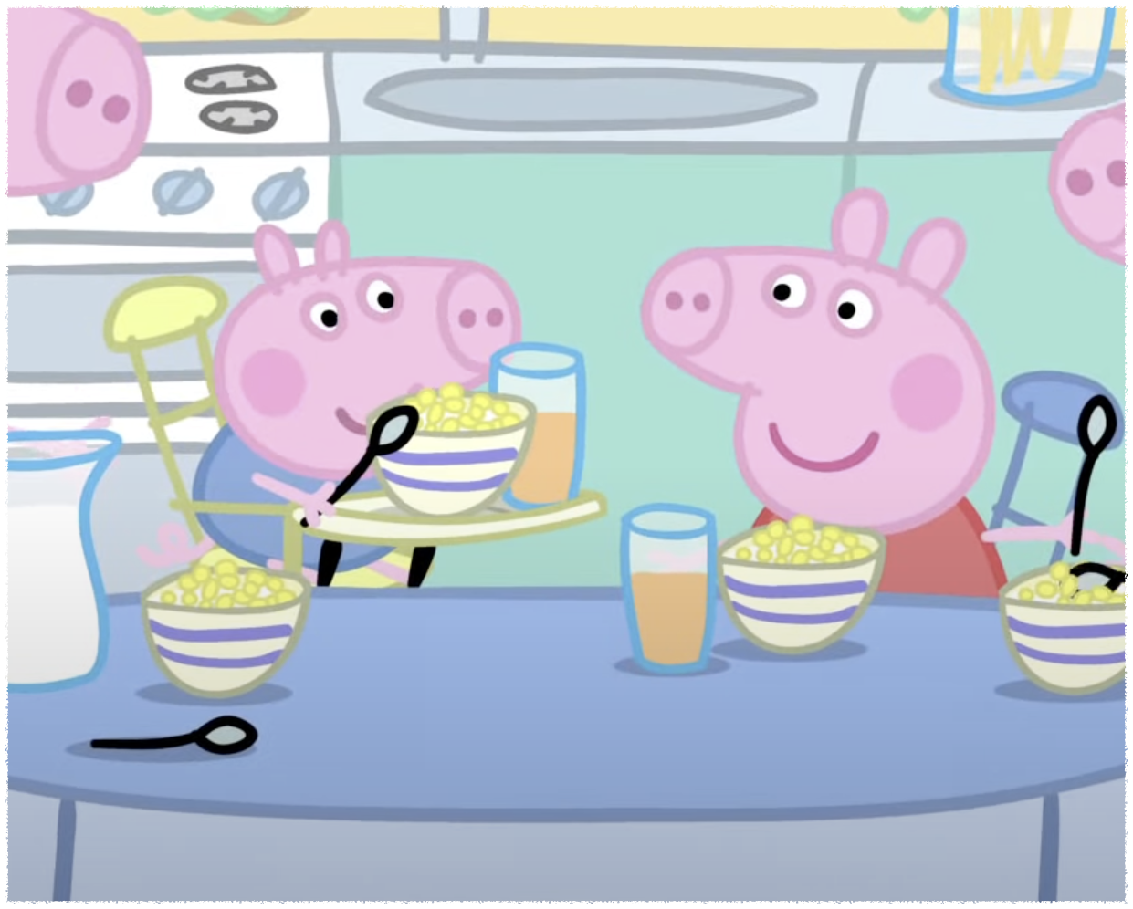
B b
Breakfast
Notes:
They are having breakfast together

Slide 4
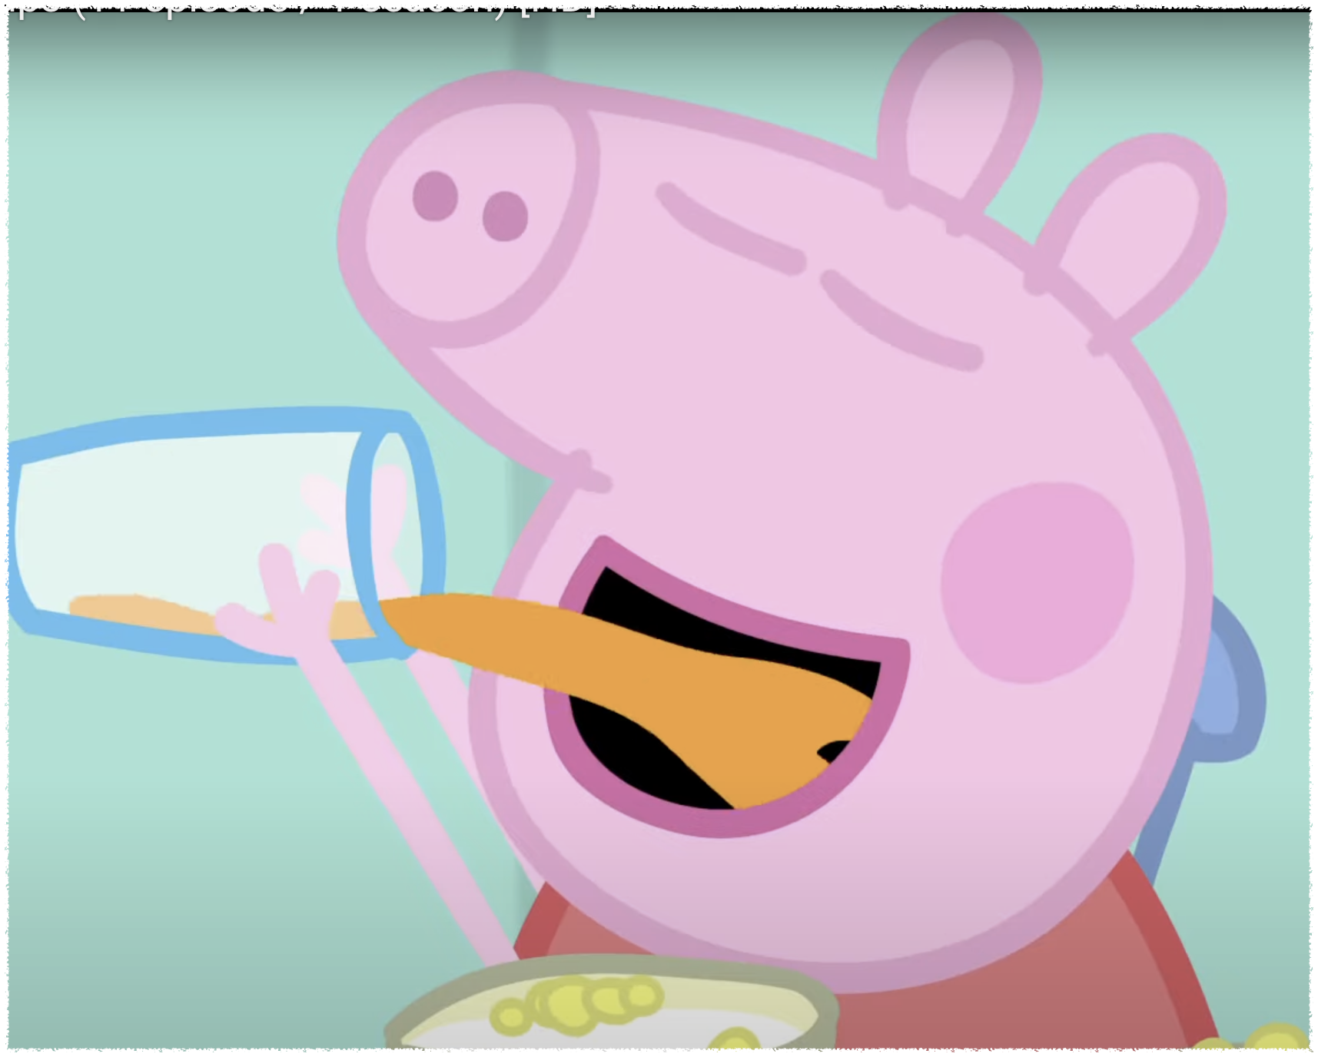
D d
Drink
Notes:
Don’t drink your juice too quickly

Slide 5
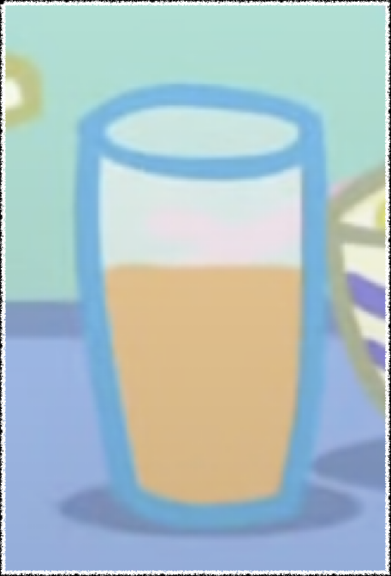
J j
Juice
Notes:
Don’t drink your juice too quickly

Slide 6
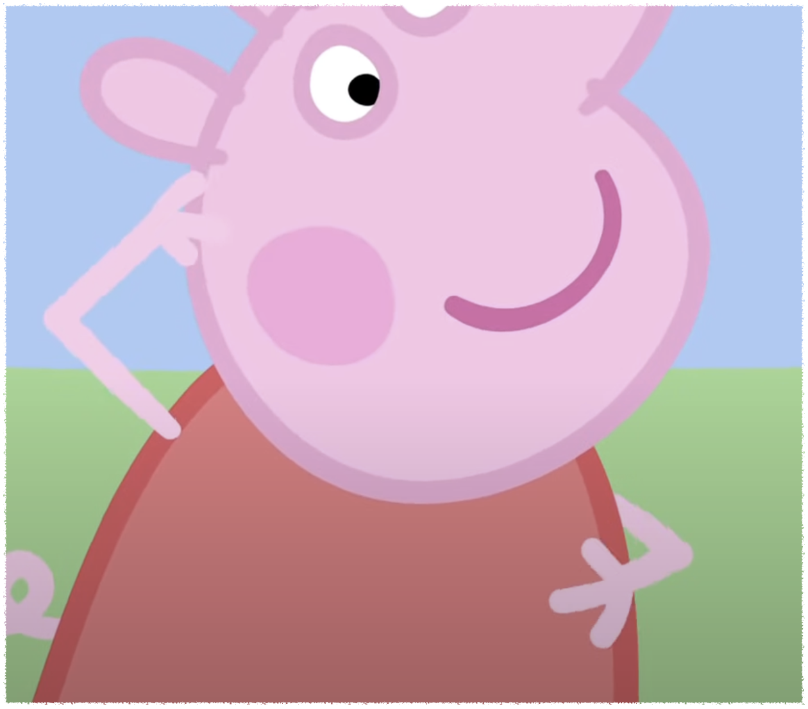
R r
Rub
Notes:
You can rub your head

Slide 7
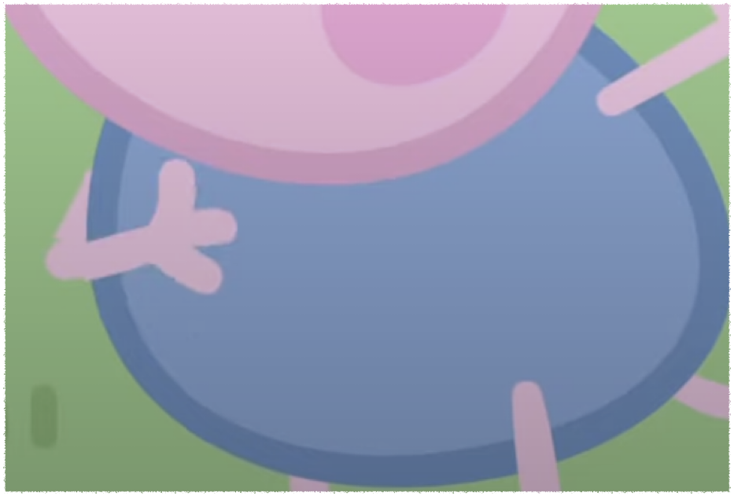
T t
Tummy
Notes:
Where is your tummy?

Slide 8
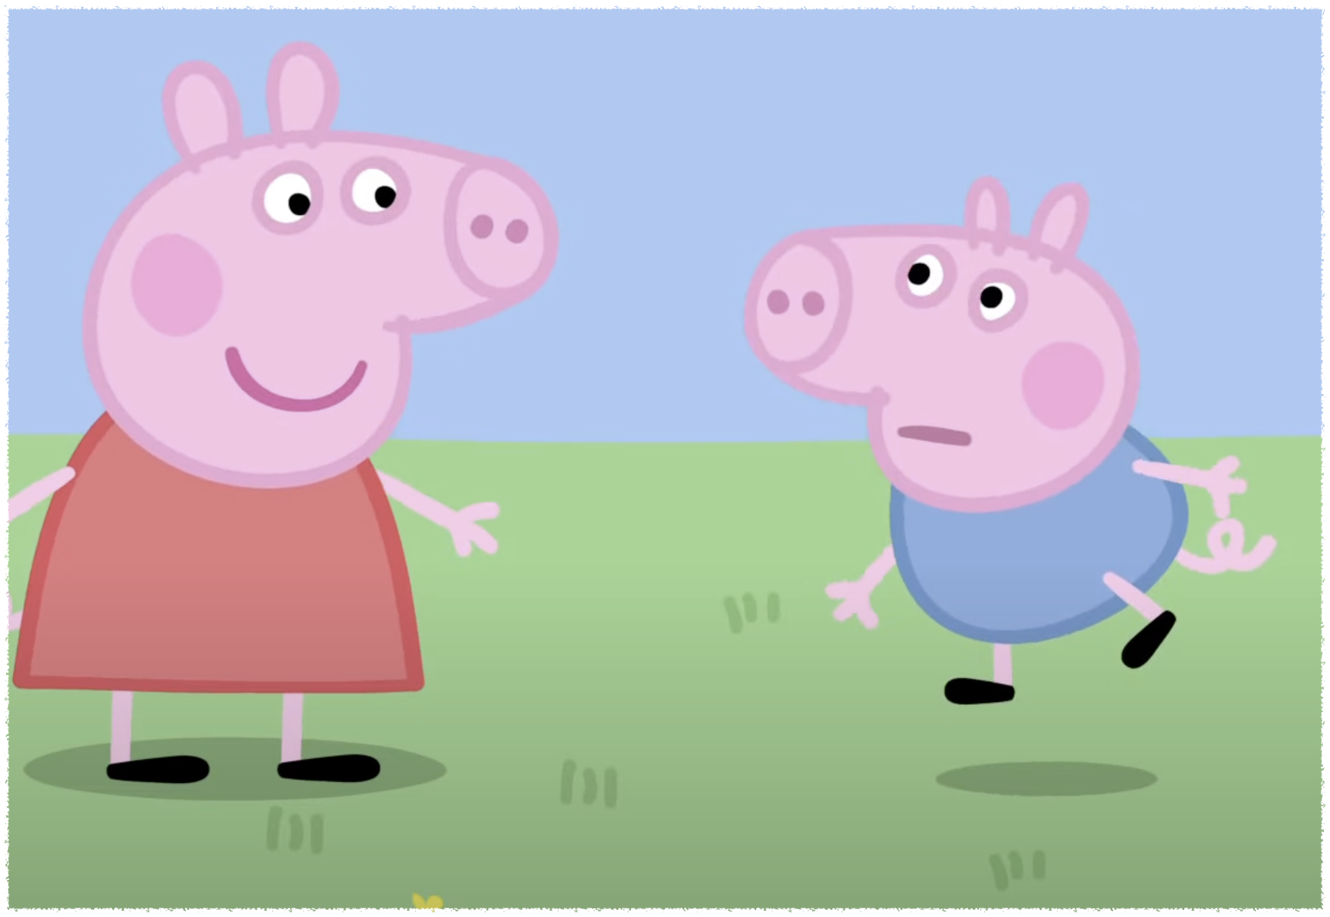
J j
Jump
Notes:
Jump up and down

Slide 9
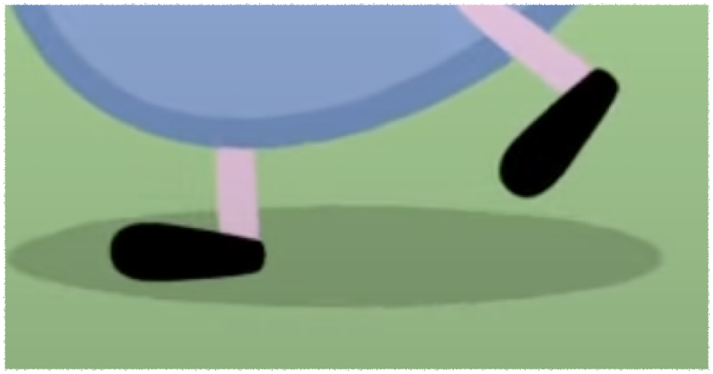
L l
Leg
Notes:
We wait for it to grow

Slide 10
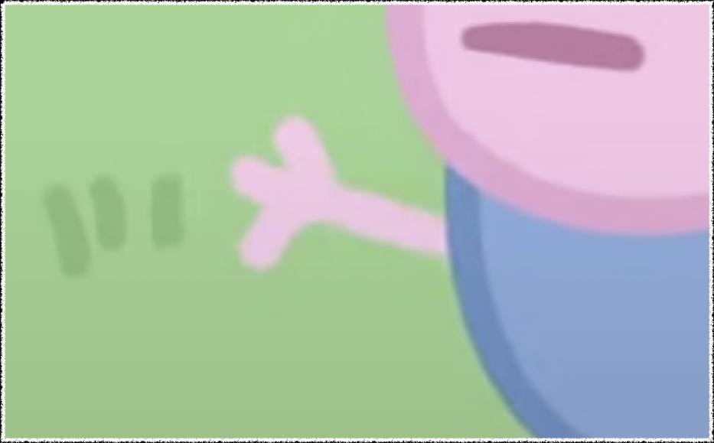
A a
Arm
Notes:
Wave your arm

Slide 11
I can't wait to going to the garden
You have to do what I say
Turn around

